Slide 1
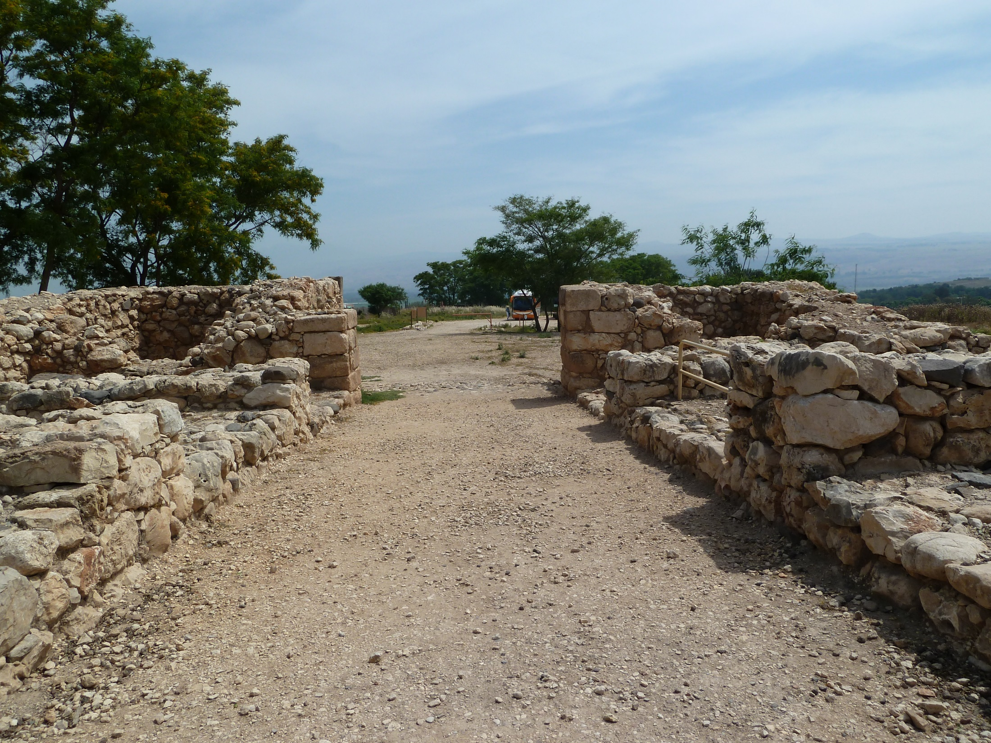
Ruth 3-4

Slide 2
3.1-2: Then Naomi her mother-in-law said to her, “My daughter, shall I not seek security for you, that it may be well with you? Now is not Boaz our kinsman, with whose maids you were? Behold, he winnows barley at the threshing floor tonight.
Abraham Boaz David Jesus

Slide 3
3.3-4: Wash yourself therefore, and anoint yourself and put on your best clothes, and go down to the threshing floor; but do not make yourself known to the man until he has finished eating and drinking. It shall be when he lies down, that you shall notice the place where he lies, and you shall go and uncover his feet and lie down; then he will tell you what you shall do.”
Abraham Boaz David Jesus

Slide 4
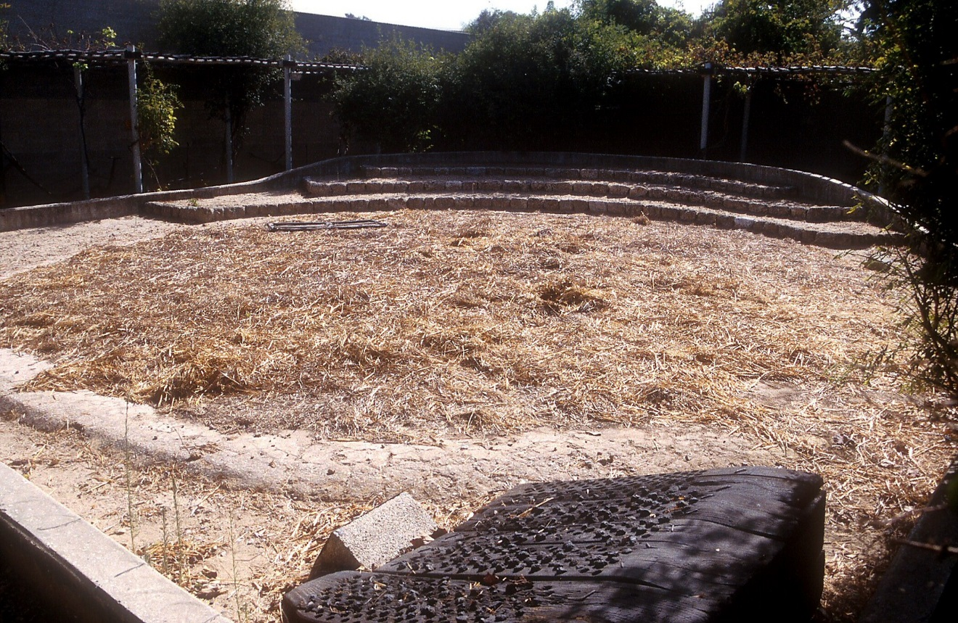

Slide 5
3.3-4: Wash yourself therefore, and anoint yourself and put on your best clothes, and go down to the threshing floor; but do not make yourself known to the man until he has finished eating and drinking. It shall be when he lies down, that you shall notice the place where he lies, and you shall go and uncover his feet and lie down; then he will tell you what you shall do.”
Abraham Boaz David Jesus

Slide 6
Deuteronomy 25.5-6 [NIV]: If brothers are living together and one of them dies without a son, his widow must not marry outside the family. Her husband's brother shall take her and marry her and fulfill the duty of a brother-in-law to her. The first son she bears shall carry on the name of the dead brother so that his name will not be blotted out from Israel.
Abraham Boaz David Jesus

Slide 7
3.3-4: Wash yourself therefore, and anoint yourself and put on your best clothes, and go down to the threshing floor; but do not make yourself known to the man until he has finished eating and drinking. It shall be when he lies down, that you shall notice the place where he lies, and you shall go and uncover his feet and lie down; then he will tell you what you shall do.”
Abraham Boaz David Jesus

Slide 8
3.5-7: She said to her, “All that you say I will do.” So she went down to the threshing floor and did according to all that her mother-in-law had commanded her. When Boaz had eaten and drunk and his heart was merry, he went to lie down at the end of the heap of grain; and she came secretly, and uncovered his feet and lay down.
Abraham Boaz David Jesus

Slide 9
3.8-9: It happened in the middle of the night that the man was startled and bent forward; and behold, a woman was lying at his feet. He said, “Who are you?” And she answered, “I am Ruth your maid. So spread your covering over your maid, for you are a
close relative.”
גָּאַל [kinsman redeemer]
Abraham Boaz David Jesus

Slide 10
3.8-9: It happened in the middle of the night that the man was startled and bent forward; and behold, a woman was lying at his feet. He said, “Who are you?” And she answered, “I am Ruth your maid. So spread your covering over your maid, for you are a
close relative.”
גָּאַל [kinsman redeemer]
כָּנָף [wings= covering of skirt/garment]
Abraham Boaz David Jesus

Slide 11
3.10-13: Then he said, “May you be blessed of the LORD, my daughter. You have shown your last kindness to be better than the first by not going after young men, whether poor or rich. Now, my daughter, do not fear. I will do for you whatever you ask, for all my people in the city know that you are a woman of excellence. Now it is true I am a close relative; however, there is a relative closer than I. Remain this night, and when morning comes, if he will redeem you, good…
Abraham Boaz David Jesus

Slide 12
3.13-15: …let him redeem you. But if he does not wish to redeem you, then I will redeem you, as the LORD lives. Lie down until morning.” So she lay at his feet until morning and rose before one could recognize another; and he said, “Let it not be known that the woman came to the threshing floor.” Again he said, “Give me the cloak that is on you and hold it.” So she held it, and he measured six measures of barley and laid it on her. Then she went into the city.
Abraham Boaz David Jesus

Slide 13
Boaz said he would ask the closer kinsman redeemer to redeem Ruth, but if he would not then Boaz would.
Does this reflect correct use of the Law?

Slide 14
Matthew 1.1-5 [NET]: This is the record of the genealogy of Jesus Christ, the son of David, the son of Abraham. Abraham was the father of Isaac, Isaac the father of Jacob, Jacob the father of Judah and his brothers, Judah the father of Perez and Zerah (by Tamar), Perez the father of Hezron, Hezron the father of Ram, Ram the father of Amminadab, Amminadab the father of Nahshon, Nahshon the father of Salmon, Salmon the father of Boaz (by Rahab), Boaz the father of Obed (by Ruth), Obed the father of Jesse, and Jesse the father of David the king.
Abraham Boaz David Jesus

Slide 15
3.16-18: When she came to her mother-in-law, she said, “How did it go, my daughter?” And she told her all that the man had done for her. She said, “These six measures of barley he gave to me, for he said, ‘Do not go to your mother-in-law empty-handed.’” Then she said, “Wait, my daughter, until you know how the matter turns out; for the man will not rest until he has settled it today.”
Abraham Boaz David Jesus

Slide 16
4.1-3: Now Boaz went up to the gate and sat down there, and behold, the close relative of whom Boaz spoke was passing by, so he said, “Turn aside, friend, sit down here.” And he turned aside and sat down. He took ten men of the elders of the city and said, “Sit down here.” So they sat down. Then he said to the closest relative, “Naomi, who has come back from the land of Moab, has to sell the piece of land which belonged to our brother Elimelech.
Abraham Boaz David Jesus

Slide 17
4.4: So I thought to inform you, saying, ‘Buy it before those who are sitting here, and before the elders of my people. If you will redeem it, redeem it; but if not, tell me that I may know; for there is no one but you to redeem it, and I am after you.’” And he said, “I will redeem it.”
Abraham Boaz David Jesus

Slide 19
4.5-6: Then Boaz said, “On the day you buy the field from the hand of Naomi, you must also acquire Ruth the Moabitess, the widow of the deceased, in order to raise up the name of the deceased on his inheritance.” ⁶The closest relative said, “I cannot redeem it for myself, because I would jeopardize my own inheritance. Redeem it for yourself; you may have my right of redemption, for I cannot redeem it.”
Abraham Boaz David Jesus

Slide 20
4.7-8: Now this was the custom in former times in Israel concerning the redemption and the exchange of land to confirm any matter: a man removed his sandal and gave it to another; and this was the manner of attestation in Israel. So the closest relative said to Boaz, “Buy it for yourself.” And he removed his sandal.
Abraham Boaz David Jesus

Slide 21
4.1: Now Boaz went up to the gate and sat down there, and behold, the close relative of whom Boaz spoke was passing by, so he said, “Turn aside, friend, sit down here.”
פְּלֹנִי = the unnamed one!

Slide 22
4.9-10: Then Boaz said to the elders and all the people, “You are witnesses today that I have bought from the hand of Naomi all that belonged to Elimelech and all that belonged to Chilion and Mahlon. Moreover, I have acquired Ruth the Moabitess, the widow of Mahlon, to be my wife in order to raise up the name of the deceased on his inheritance, so that the name of the deceased will not be cut off from his brothers or from the court of his birth place; you are witnesses today.”
Abraham Boaz David Jesus

Slide 23
4.11-12: All the people who were in the court, and the elders, said, “We are witnesses. May the LORD make the woman who is coming into your home like Rachel and Leah, both of whom built the house of Israel; and may you achieve wealth in Ephrathah and become famous in Bethlehem. Moreover, may your house be like the house of Perez whom Tamar bore to Judah, through the offspring which the LORD will give you by this young woman.”
Abraham Boaz David Jesus

Slide 24
4.13: So Boaz took Ruth, and she became his wife, and he went in to her. And the LORD enabled her to conceive, and she gave birth to a son.
Abraham Boaz David Jesus

Slide 25
4.14-15: Then the women said to Naomi, "Blessed is the LORD who has not left you without a redeemer today, and may his name become famous in Israel. ¹⁵May he also be to you a restorer of life and a sustainer of your old age; for your daughter-in-law, who loves you and is better to you than seven sons, has given birth to him.”
Abraham Boaz David Jesus

Slide 26
4.16: Then Naomi took the child and laid him in her lap, and became his nurse.
Abraham Boaz David Jesus

Slide 27
4.17-22: The neighbor women gave him a name, saying, “A son has been born to Naomi!” So they named him Obed. He is the father of Jesse, the father of David. Now these are the generations of Perez: to Perez was born Hezron, and to Hezron was born Ram, and to Ram, Amminadab, and to Amminadab was born Nahshon, and to Nahshon, Salmon, and to Salmon was born Boaz, and to Boaz, Obed, and to Obed was born Jesse, and to Jesse, David.
Abraham Boaz David Jesus

Slide 28
Abraham Boaz David Jesus
Time of Judges
King after God’s own heart

Slide 29
Abraham Boaz David Jesus
Covenant Righteous
created Under Representative
nation Mosaic King
Covenant
Law
Ultimate Redeemer
and representative of God

Slide 30
Abraham Boaz David Jesus
Chosen from Mosaic Will
outside Law provide
to found codified for
new nation passing on faithful
of God’s blessing of any
people to nations race

Slide 31
Abraham Boaz David Jesus
Mosaic New
Covenant Covenant

Slide 32
Abraham Boaz David Jesus
Redeemer seed
from his family
Redeemer seed through this line of Abraham’s family then through David…

Slide 33
Abraham Boaz David Jesus
Redeems widow
Redeems land
Redeems lost people

